Slide 1
Data Science Process
Lecture – 4, 5 (Part-2)
Sumita Narang

Slide 2
Objectives
Data Science methodology
Business understanding
Data Requirements
Data Acquisition
Data Understanding
Data preparation
Modelling
Model Evaluation
Deployment and feedback
Case Study
Data Science Proposal
Samples
Evaluation
Review Guide

Slide 3
Stage 4: Data Modelling
Split correctly the data
Choose a measure of success. Set an evaluation protocol and the different protocols available.
Develop a benchmark model
Choose an adequate model and tune it to get the best performance possible. An overview of how a model learns.
What is regularization and when is appropriate to use it.
Differentiate between over and under fitting, defining what they are and explaining the best ways to avoid them
4

Slide 4
Modelling & Evaluation
1. Data Model Development & experiment framework setup
2. Data Model Evaluation & KPI Checks
Data Modelling based on training sets
Read papers, research material to finalize the algorithmic approaches
Framework to feed in new data and test the models
Framework to change training data and retrain model based on new data sets as sliding window
3 main tasks involved -
Feature Engineering: Create data features from the raw data to facilitate model training
Model Training: Find the model that answers the question most accurately by comparing their success metrics
Determine if your model is suitable for production

Slide 5


Define Appropriately the
Problem
The first, and one of the most critical things to do, is to find out what are the
inputs and the expected outputs. The following questions must be answered:
•
What is the main objective? What are we trying to predict?
•
What are the target features?
•
What is the input data? Is it available?
•
What kind of problem are we facing? Binary classification? Clustering?
•
What is the expected improvement?
•
What is the current status of the target feature?
•
How is going to be measured the target feature?
5
BITS Pilani, Pilani Campus

Slide 6
Choose a Measure of Success
“If you can’t measure it you can’t improve it”.
If you want to control something it should be observable, and in order to
achieve success, it is essential to define what is considered success: Maybe
precision? accuracy? Customer-retention rate?
This measure should be directly aligned with the higher level goals of the
business at hand. And it is also directly related with the kind of problem we are
facing:
•
Regression problems use certain evaluation metrics such as mean squared
error (MSE).
•
Classification problems use evaluation metrics as precision, accuracy and
recall.
8
BITS Pilani, Pilani Campus

Slide 7
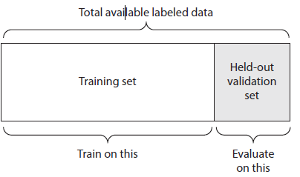
Setting an Evaluation Protocol 1/
Maintaining a Hold Out Validation Set
This method consists on setting apart some portion of the data as the test set.
The process would be to train the model with the remaining fraction of the data,
tuning its parameters with the validation set and finally evaluating its
performance on the test set.
The reason to split data in three parts is to avoid information leaks. The main
inconvenient of this method is that if there is little data available, the validation
and test sets will contain so few samples that the tuning and evaluation
processes of the model will not be effective.
This is a simple kind of cross validation technique, also known as the holdout method. Although this method doesn’t take any overhead to compute and is better than traditional validation, it still suffers from issues of high variance. This is because it is not certain which data points will end up in the validation set and the result might be entirely different for different sets.
Reduce Bias Error
Reduce Variance Error
9
BITS Pilani, Pilani Campus

Slide 8
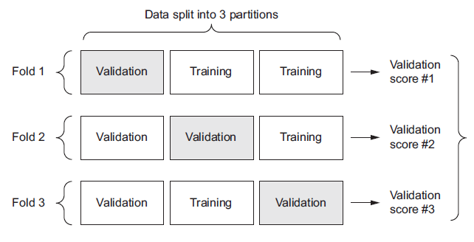
Setting an Evaluation Protocol 2/
K-Fold Validation Method
K-Fold consists in splitting the data into K partitions of equal size. For each
partition i, the model is trained with the remaining K-1 partitions and it is
evaluated on partition i.
The final score is the average of the K scored obtained. This technique is
specially helpful when the performance of the model is significantly different
from the train-test split.
As there is never enough data to train your model, removing a part of it for validation poses a problem of under-fitting. By reducing the training data, we risk losing important patterns/ trends in data set, which in turn increases error induced by bias. So, what we require is a method that provides ample data for training the model and also leaves ample data for validation. K Fold cross validation does exactly that.
K-fold cross validation significantly reduces bias as we are using most of the data for fitting, and also significantly reduces variance as most of the data is also being used in validation set.
10
BITS Pilani, Pilani Campus

Slide 9

Cross-Validation (1/3)
• Cross-Validation is a very useful technique for assessing the performance
of machine learning models.
• Helps in knowing how the machine learning model would generalize to an
independent data set.
• Helps in estimating how accurate the predictions will be in practice.
• We are given two type of data sets: known data set (training data set) and
unknown data set (test data set).
• There are different types of Cross-Validation techniques but the overall
concept remains the same:
o To partition the overall dataset into a number of subsets
o Hold out a subset at a time and train the model on remaining subsets
o Test model on hold out subset
Sources: https://towardsdatascience.com/cross-validation-explained-evaluating-estimator-performance-e51e5430ff85
https://magoosh.com/data-science/k-fold-cross-validation/
19
BAZG523(Introduction to Data Science)
https://towardsdatascience.com/cross-validation-in-machine-learning-72924a69872f

Slide 10
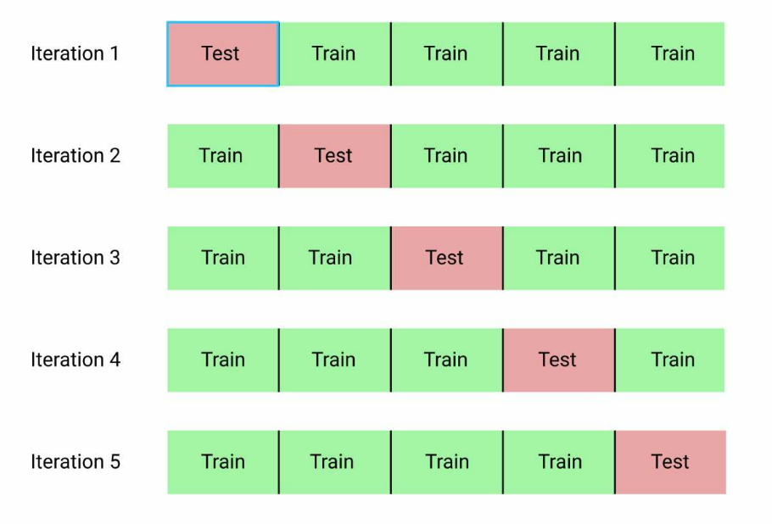
Cross-Validation (2/3)
K-Fold Cross-Validation: If k=5 the dataset will be divided into 5 equal parts
and the below process will run 5 times, each time with a different holdout set.
1. Take a group as a test data set
2. Take the remaining groups as a training data set
3. Fit a model on the training set and evaluate it on the test data set
4. Retain the evaluation score and discard the model
At the end of the above process summarize the skill of the model using the
average of model evaluation scores.
Sources: https://towardsdatascience.com/cross-validation-explained-evaluating-estimator-performance-e51e5430ff85
https://magoosh.com/data-science/k-fold-cross-validation/
20
BAZG523(Introduction to Data Science)

Slide 11
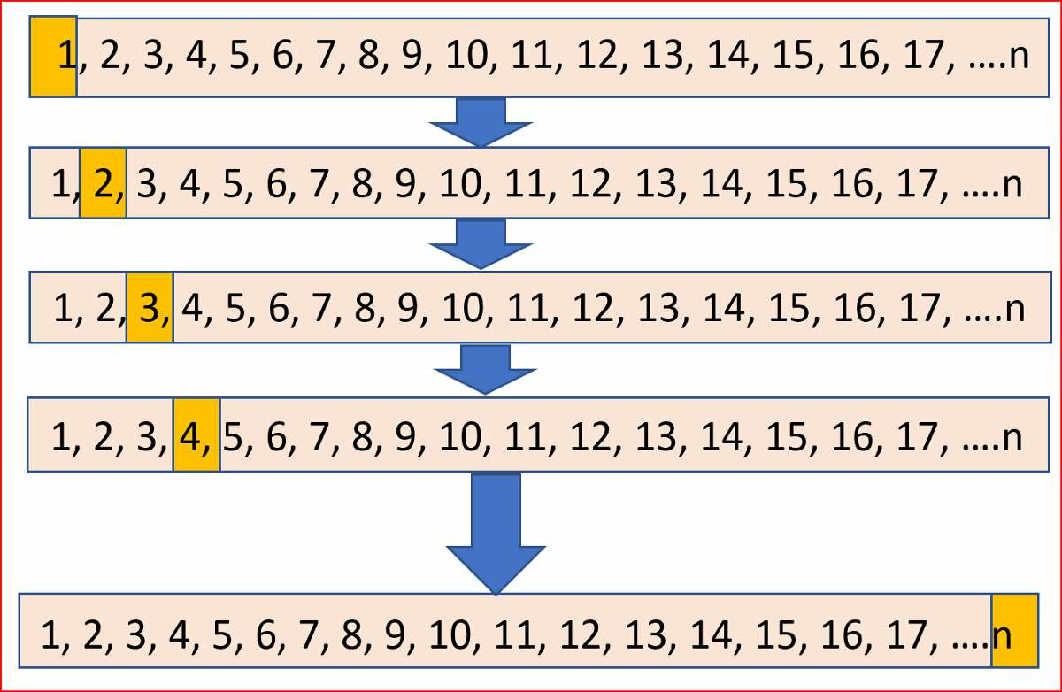
Cross-Validation (3/3)
Leave One Out Cross-Validation : It is K-fold cross validation taken to its
logical extreme, with K equal to N, the number of data points in the dataset.
Sources: https://towardsdatascience.com/cross-validation-explained-evaluating-estimator-performance-e51e5430ff85
https://magoosh.com/data-science/k-fold-cross-validation/
21
BAZG523(Introduction to Data Science)

Slide 12
Setting an Evaluation Protocol 3/
Stratified K-Fold Cross validation
In some cases, there may be a large imbalance in the response variables. For example, in dataset concerning price of houses, there might be large number of houses having high price. Or in case of classification, there might be several times more negative samples than positive samples.
For such problems, a slight variation in the K Fold cross validation technique is made, such that each fold contains approximately the same percentage of samples of each target class as the complete set, or in case of prediction problems, the mean response value is approximately equal in all the folds. This variation is also known as Stratified K Fold.

Slide 13
Setting an Evaluation Protocol 4/
Iterated K-Fold Validation with Shuffling (Random Sub-sampling)
It consist on applying K-Fold validation several times and shuffling the data
every time before splitting it into K partitions. The Final score is the average of
the scores obtained at the end of each run of K-Fold validation.
This method can be very computationally expensive, as the number of trained
and evaluating models would be I x K times. Being I the number of iterations
and K the number of partitions.
Above explained validation techniques are also referred to as Non-exhaustive cross validation methods. These do not compute all ways of splitting the original sample, i.e. you just have to decide how many subsets need to be made.
11
BITS Pilani, Pilani Campus

Slide 14
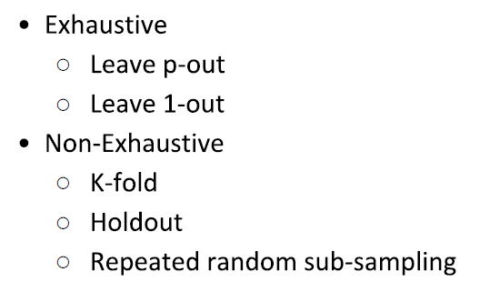
Non-Exhaustive & Exhaustive Cross-Validation Techniques
References-
https://towardsdatascience.com/cross-validation-in-machine-learning-72924a69872f
https://blog.contactsunny.com/data-science/different-types-of-validations-in-machine-learning-cross-validation

Slide 15
Exhaustive Cross Validation Methods 1/
Exhaustive Methods, that computes all possible ways the data can be split into training and test sets.
Leave-P-Out Cross Validation
This approach leaves p data points out of training data, i.e. if there are n data points in the original sample then, n-p samples are used to train the model and p points are used as the validation set.
This is repeated for all combinations in which original sample can be separated this way, and then the error is averaged for all trials, to give overall effectiveness.
This method is exhaustive in the sense that it needs to train and validate the model for all possible combinations, and for moderately large p, it can become computationally infeasible.

Slide 16
Exhaustive Cross Validation Methods 2/
Leave-1-Out Cross Validation
A particular case of this method is when p = 1. This is known as Leave one out cross validation. This method is generally preferred over the previous one because it does not suffer from the intensive computation, as number of possible combinations is equal to number of data points in original sample or n.

Slide 17
Predictive Modelling
Predictive modeling refers to the task of building a model for the target variable as a function of the explanatory variables. There are two types of predictive modeling tasks:
Classification, which is used for discrete target variables, and regression, which is used for continuous target variables. For example, predicting whether a Web user will make a purchase at an online bookstore is a classification task because the target variable is binary-valued.
On the other hand, forecasting the future price of a stock is a regression task because price is a continuous-valued attribute. The goal of both tasks is to learn a model that minimizes the error between the predicted and true values of the target variable.
Predictive modeling can be used to identify customers that will respond to a marketing campaign, predict disturbances in the Earth's ecosystem, or judge whether a patient has a particular disease based on the results of medical tests.

Slide 18
Classification Predictive Modelling Techniques
In classification problems, we use two types of algorithms (dependent on the kind of output it creates):
Class output: Algorithms like SVM and KNN create a class output. For instance, in a binary classification problem, the outputs will be either 0 or 1. However, today we have algorithms which can convert these class outputs to probability. But these algorithms are not well accepted by the statistics community.
Probability output: Algorithms like Logistic Regression, Random Forest, Gradient Boosting, Adaboost etc. give probability outputs. Converting probability outputs to class output is just a matter of creating a threshold probability.
Classification Algorithms vs Clustering Algorithms
In clustering, the idea is not to predict the target class as in classification, it’s more ever trying to group the similar kind of things by considering the most satisfied condition, all the items in the same group should be similar and no two different group items should not be similar.

Slide 19
Developing a Benchmark model
Benchmarking is the process of comparing your result to existing methods. You may compare to published results using another paper, for example. If there is no other obvious methodology against which you can benchmark, you might compare to the best naive solution (guessing the mean, guessing the majority class, etc.) or a very simple model (a simple regression, K Nearest Neighbors). If the field is well studied, you should probably benchmark against the current published state of the art (and possibly against human performance when relevant).
Null Model Bayes rate model
Single-variable models (e.g Pivot tables)
https://towardsdatascience.com/creating-benchmark-models-the-scikit-learn-way-af227f6ea977
17
BITS Pilani, Pilani Campus

Slide 20
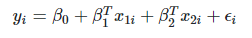
Null Model – Null Hypothesis
Null model for Univariate regression model –
Y=α + β₁X+ ϵ
Null hypothesis would normally be that β1 is statistically no different from zero.
H0: β₁=0 (null hypothesis)
HA: β₁≠0 (alternative hypothesis)
For a univariate linear model, such as the above, if we were to reject the alternative hypothesis then we could drop β₁X from the linear model and we'd be left with
Y=α+ϵ
this is your Null model and the same as mean of Y.
Null Model (Single Variable Models) for Bi-variate regression model -
where x₁ contains the predictors you know are affecting the outcome, so are not wanting to test, while x₂ contains the predictors you are testing.
So the null hypothesis will be β₂=0 and the null model would be –

Slide 21
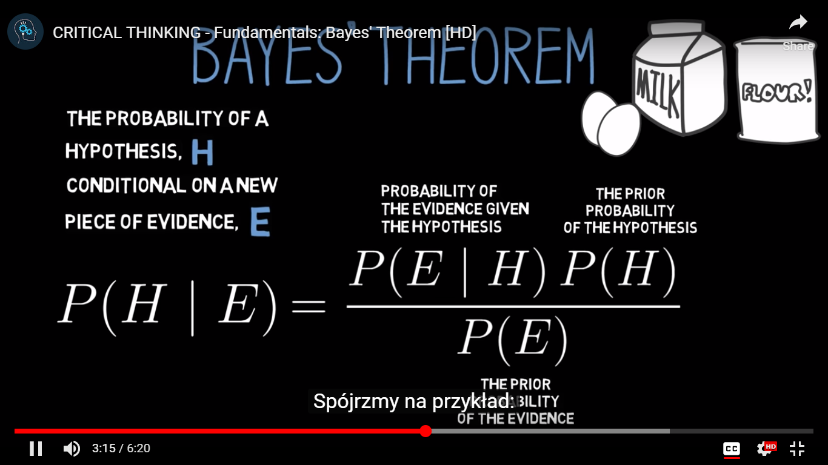
Naive Bayes Classifier
In simple terms, a Naive Bayes classifier assumes that the presence of a particular feature in a class is unrelated to the presence of any other feature.
Bayes theorem: This theorem helps to calculate conditional probability of occurrence of a hypothesis H, if the Evidence E is true, given the prior probability of H, and probability of occurrence of Evidence E.
P(H|E) = P(E|H) . P(H) / P (E)
https://www.khanacademy.org/partner-content/wi-phi/wiphi-critical-thinking/wiphi-fundamentals/v/bayes-theorem
Example –
P(H|E) → To find the conditional probability that I have Dengu, given the evidence that I show symptoms of Head ache.
Given -
P(H) = Prior Probability that I can have a disease like Dengu
P(E) = Probability that I can have head ache (due to any reason – dengu or not dengu)
P(E|H) = Probability that I can have Head ache, given the condition that I have dengu

Slide 22
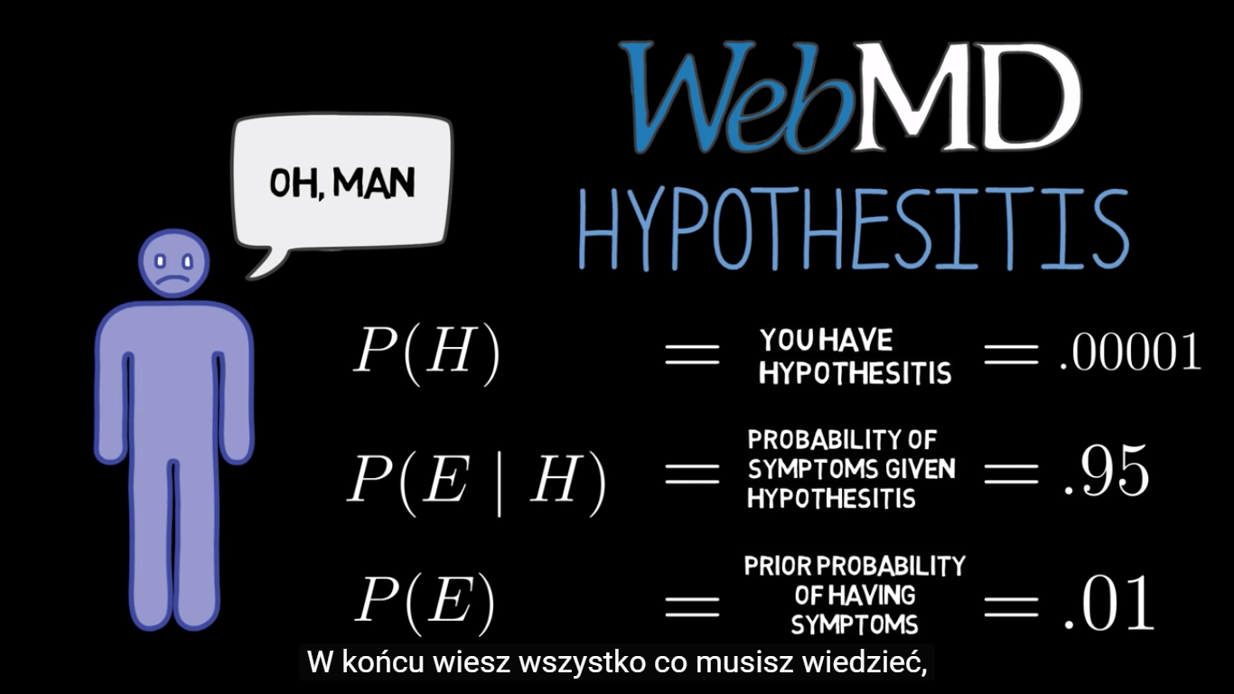
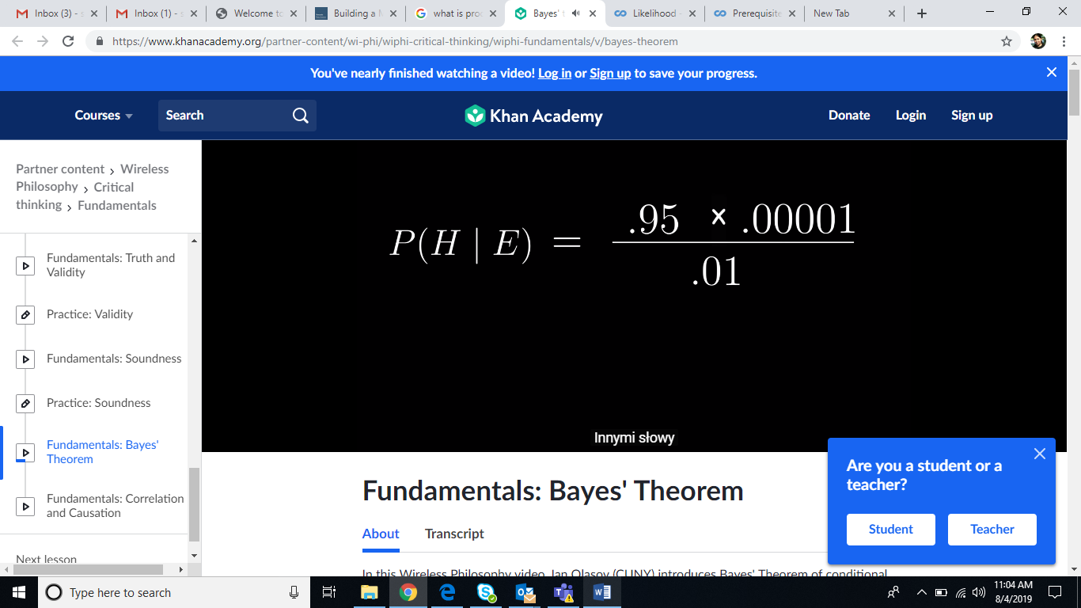

Linear Classifiers
- Naive Bayes classifier

Slide 23
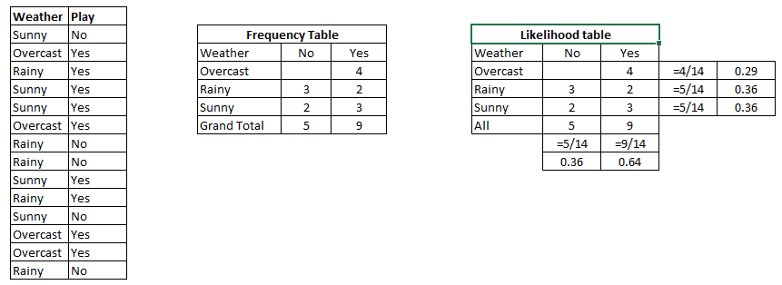
How Naive Bayes algorithm works?
https://www.analyticsvidhya.com/blog/2017/09/naive-bayes-explained/
It is easy and fast to predict class of test data set. It also perform well in multi class prediction
Step 1: Convert the data set into a frequency table
Step 2: Create Likelihood table by finding the probabilities like Overcast probability = 0.29 and probability of playing is 0.64.
Step 3: Now, use Naive Bayesian equation to calculate the posterior probability for each class. The class with the highest posterior probability is the outcome of prediction.

Slide 24
How Naive Bayes algorithm works?
Problem: Players will play if weather is sunny. Is this statement is correct?
We can solve it using above discussed method of posterior probability.
P(Yes | Sunny) = P( Sunny | Yes) * P(Yes) / P (Sunny)
Here we have P (Sunny |Yes) = 3/9 = 0.33, P(Sunny) = 5/14 = 0.36, P( Yes)= 9/14 = 0.64
Now, P (Yes | Sunny) = 0.33 * 0.64 / 0.36 = 0.60, which has higher probability.
Naive Bayes uses a similar method to predict the probability of different class based on various attributes. This algorithm is mostly used in text classification and with problems having multiple classes.

Slide 25
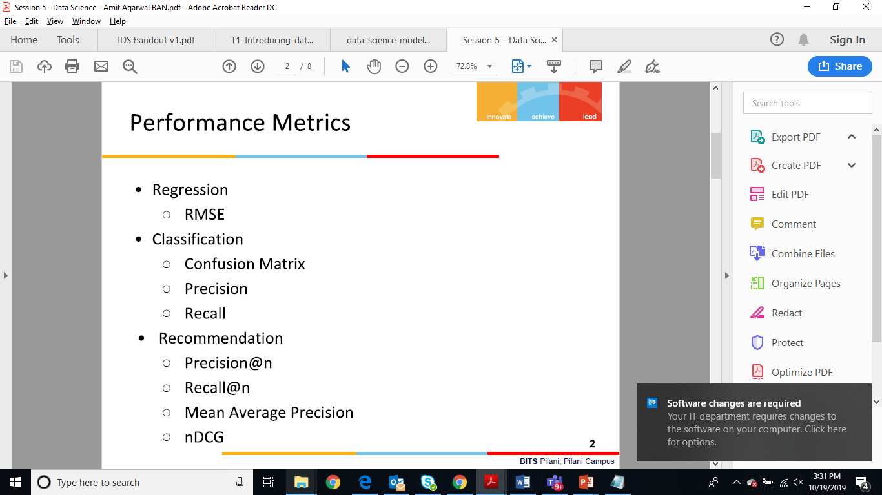
Stage 5: Model Evaluation Metrics
Performance Metrics vary based on type of models i.e. Classification Models, Clustering Models, Regression Models.
https://www.analyticsvidhya.com/blog/2019/08/11-important-model-evaluation-error-metrics/

Slide 26
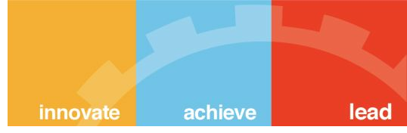




Validating models
Identifying common model problems
Bias - Systematic Error
Variance - Undesirable (but non-systematic) distance
between predictions and actual values.
Overfit
Nonsignificance: A model that appears to show an
important relation when in fact the relation may not hold
in the general population, or equally good predictions
can be made without the relation.
29
BITS Pilani, Pilani Campus

Slide 27

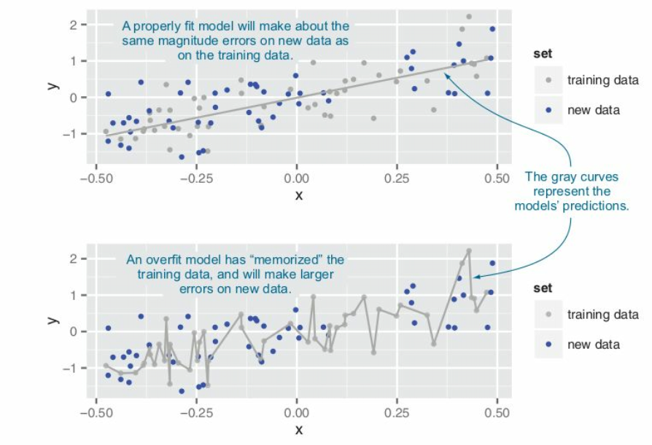
Validating models
30
BITS Pilani, Pilani Campus

Slide 28
Ensuring model quality
Testing On Hold Out Data
k-fold cross-validation
The idea behind k-fold cross-validation is to repeat the construction
of the model on different subsets of the available training data and
then evaluate the model only on data not seen during construction.
This is an attempt to simulate the performance of the model on
unseen future data.
Significance Testing
“What is your p-value?”
31
BITS Pilani, Pilani Campus

Slide 29
Balancing Bias & Variance to Control Errors in Machine Learning
https://towardsdatascience.com/balancing-bias-and-variance-to-control-errors-in-machine-learning-16ced95724db
Y = f(X) + e
Estimation of this relation or f(X) is known as statistical learning. On general, we won’t be able to make a perfect estimate of f(X), and this gives rise to an error term, known as reducible error. The accuracy of the model can be improved by making a more accurate estimate of f(X) and therefore reducing the reducible error. But, even if we make a 100% accurate estimate of f(X), our model won’t be error free, this is known as irreducible error(e in the above equation). The quantity e may contain unmeasured variables that are useful in predicting Y : since we don’t measure them, f cannot use them for its prediction. The quantity e may also contain unmeasurable variation.
Bias
Bias refers to the error that is introduced by approximating a real-life problem, which may be extremely complicated, by a much simpler model. So, if the true relation is complex and you try to use linear regression, then it will undoubtedly result in some bias in the estimation of f(X). No matter how many observations you have, it is impossible to produce an accurate prediction if you are using a restrictive/ simple algorithm, when the true relation is highly complex.
Variance
Variance refers to the amount by which your estimate of f(X) would change if we estimated it using a diﬀerent training data set. Since the training data is used to ﬁt the statistical learning method, diﬀerent training data sets will result in a diﬀerent estimation. But ideally the estimate for f(X) should not vary too much between training sets. However, if a method has high variance then small changes in the training data can result in large changes in f(X).
A general rule is that, as a statistical method tries to match data points more closely or when a more flexible method is used, the bias reduces, but variance increases.
In order to minimize the expected test error, we need to select a statistical learning method that simultaneously achieves low variance and low bias.

Slide 30
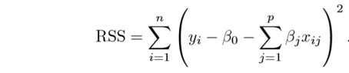
Regularization 1/
https://towardsdatascience.com/regularization-in-machine-learning-76441ddcf99a
This is a form of regression, that constrains/ regularizes or shrinks the coefficient estimates towards zero. In other words, this technique discourages learning a more complex or flexible model, so as to avoid the risk of overfitting.
A simple relation for linear regression looks like this. Here Y represents the learned relation and β represents the coefficient estimates for different variables or predictors(X).
Y ≈ β0 + β1X1 + β2X2 + …+ βpXp
The fitting procedure involves a loss function, known as residual sum of squares or RSS. The coefficients are chosen, such that they minimize this loss function. Now, this will adjust the coefficients based on your training data. If there is noise in the training data, then the estimated coefficients won’t generalize well to the future data. This is where regularization comes in and shrinks or regularizes these learned estimates towards zero.

Slide 31
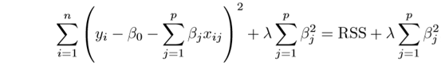
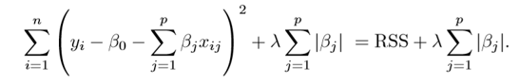
Regularization 2/
Ridge Regression
Above image shows ridge regression, where the RSS is modified by adding the shrinkage quantity. Now, the coefficients are estimated by minimizing this function. Here, λ is the tuning parameter that decides how much we want to penalize the flexibility of our model. The increase in flexibility of a model is represented by increase in its coefficients, and if we want to minimize the above function, then these coefficients need to be small. This is how the Ridge regression technique prevents coefficients from rising too high.
Lasso Regression
What does Regularization achieve?
A standard least squares model tends to have some variance in it, i.e. this model won’t generalize well for a data set different than its training data. Regularization, significantly reduces the variance of the model, without substantial increase in its bias. So the tuning parameter λ, used in the regularization techniques described above, controls the impact on bias and variance. As the value of λ rises, it reduces the value of coefficients and thus reducing the variance. Till a point, this increase in λ is beneficial as it is only reducing the variance(hence avoiding overfitting), without loosing any important properties in the data. But after certain value, the model starts loosing important properties, giving rise to bias in the model and thus underfitting. Therefore, the value of λ should be carefully selected.

Slide 32
Stage 6 - Data Visualization & Interpret Results
Record Information
Blueprints, photographs, seismographs, …
Analyze data to support reasoning
Understand your data better and act upon that understanding
Develop and assess hypotheses (visual exploration) Find patterns and discover errors in data
Communicate information
Share and persuade (visual explanation)
more effectively

Slide 33
Classification of Visualization 1/
5 Types of Data Visualization Categories
Temporal
2 conditions: that they are linear, and are one-dimensional.
Temporal visualizations normally feature lines that either stand alone or overlap with each other, with a start and finish time.
Hierarchical
those that order groups within larger groups. Hierarchical visualizations are best suited if you’re looking to display clusters of information, especially if they flow from a single origin point.
Easy to read graphs
more complex and difficult to read,

Slide 34
Classification of Visualization 2/
Network
Datasets connect deeply with other datasets. Network data visualizations show how they relate to one another within a network. In other words, demonstrating relationships between datasets without wordy explanations.
Multidimensional
there are always 2 or more variables in the mix to create a 3D data visualization.
Because of the many concurrent layers and datasets, these types of visualizations tend to be the most vibrant or eye-catching visuals. Another plus? These visuals can break down a ton of data down to key takeaways.
Geospatial
relate to real life physical locations, overlaying familiar maps with different data points.
These types of data visualizations are commonly used to display sales or acquisitions over time, and can be most recognizable for their use in political campaigns or to display market penetration in multinational corporations.

Slide 35
Classification of Visualization 3/
Temporal
Scatter plots
Hierarchical
Tree diagrams
Network
Matrix charts
Polar area diagrams
Time series sequences
Timelines
Line graphs
Ring charts
Sunburst diagrams
Node-link diagrams
Word clouds
Alluvial diagrams
Multidimensional
Box plots
Pie charts
Venn diagrams
Stacked bar graphs
Histograms
Geospatial
Flow map
Density map
Cartogram
Heat map
https://www.klipfolio.com/resources/articles/what-is-data-visualization

Slide 36
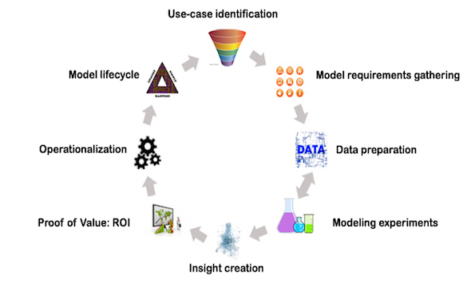
Sage 7 - Deployment & Iterative Lifecycle
Standard Methodology for Analytical Models (SMAM)
Operationalization –
Implementing the model as a deployable software solution

Slide 37
Deployment Phase
1. Solution Productionizing & Monitoring Setup
2. Solution Deployment
Research language may or may not be possible to use in productionizing
Hosting solution in company’s data centers or on cloud based on company’s policies , infrastructure and cost
If Research and productionizing language is different; porting the algorithm; finding related libraries & writing custom code; writing wrapper APIs
If both are same; how to make models more scalable & achieve required efficiency;
Devise mechanism to continuously monitor the performance of model setup
KPI Check
Validating that target KPIs are met

Slide 38
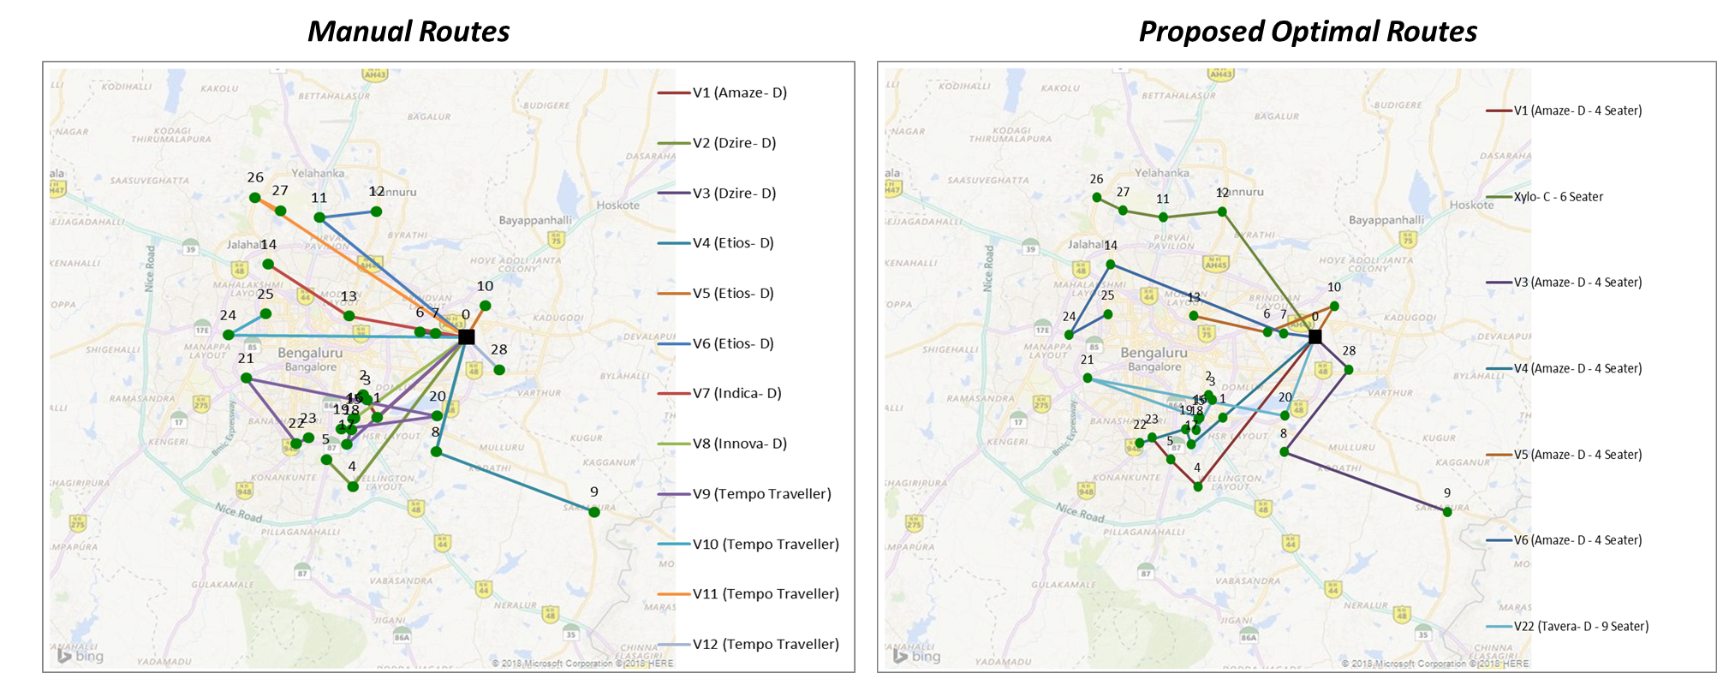
<Transportation/ Logistics><Optimization Algorithms>
Problem Statement
Solution Approach
Solution Benefits
ABC Organization allows employees to request cab service for scheduled time slots, having well-defined drop/pick up locations
Services team manually creates routes for the given requests, which are often sub-optimal
Used Large Neighborhood Search (LNS) – AI Search Metaheuristic
Constraints built into LNS as Rules
Overall Cost Optimization (Fuel, Security) and Travel Time Optimization
No tedious manual planning required; more time window for user requests
Time | Date | Savings | Total No. of Customers | No. of Manual routes | No. of proposed routes | Vehicles used in manual routes | Vehicles used in optimized routes
7:00 PM | 1/19/2018 | 56% | 28 | 12 | 7 | 1 Amaze- D, 2 Dzire D, 3 Etios D,1 Indica D,1 Innova D, 4 Tempo Traveller | 6 Amaze D 4 seater, 1 Tavera D 9 Seater
Notes:
Intelligent Traffic Management – e.g. CMU V2V traffic management system
Logistics – Delivery Route

Slide 39
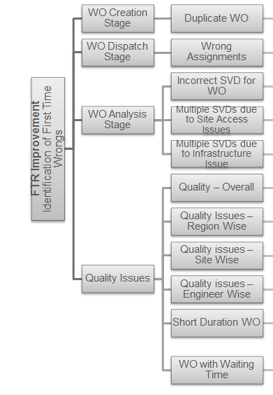
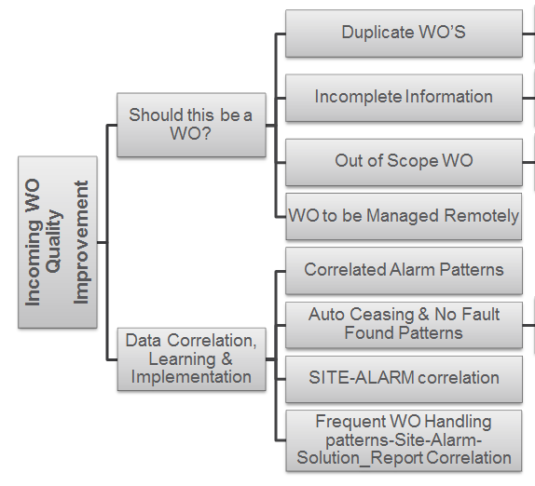
Project Example of Data Science
- Diagnostic Analytics
FSO analytics example –
Business Objective fro FSO Department: Target for 5 top clients in India, Europe, South Africa and Costa Rica Markets
FTR (Frist Time Right) Improvement by 2%
Improve incoming WO Quality by 5%

Slide 40
References
https://www.bouvet.no/bouvet-deler/roles-in-a-data-science-project
https://www.altexsoft.com/blog/datascience/how-to-structure-data-science-team-key-models-and-roles/
https://www.quora.com/What-is-the-life-cycle-of-a-data-science-project
https://towardsdatascience.com/5-steps-of-a-data-science-project-lifecycle-26c50372b492
https://www.dezyre.com/article/life-cycle-of-a-data-science-project/270
https://www.slideshare.net/priyansakthi/methods-of-data-collection-16037781
https://www.questionpro.com/blog/qualitative-data/
https://surfstat.anu.edu.au/surfstat-home/1-1-1.html
https://www.mymarketresearchmethods.com/types-of-data-nominal-ordinal-interval-ratio/
https://www.coursera.org/learn/decision-making

